Slide 1
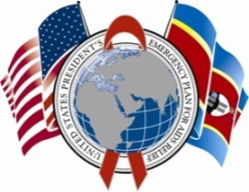
The Lubombo Child Friendly Court: A Pilot of Social Work Systems Strengthening in Swaziland NSWM Conference Washington, DC
June 4, 2015
Zee C. Masuku
SW Advisor, Health Finance and Governance Project

Slide 2
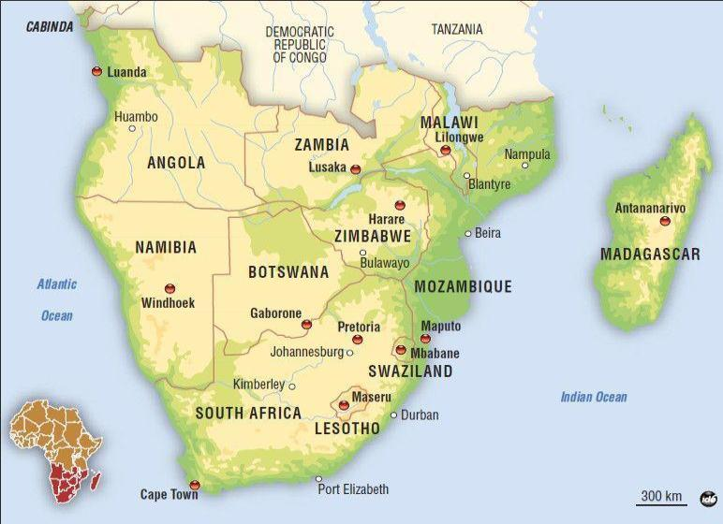
Swaziland
Population:
1.2M
Notes:
Intervention, programs and benefits provided by government, civil society and community actors to support DSW

Slide 3
OVC Situation in Swaziland
27% HIV/AIDS prevalence in the general population*
45% of all children are orphaned or vulnerable**
63% of the total population lives below the poverty line and 29% live in extreme poverty**
Sexual violence among children and young women***:
28% among children 13-17 years old
38% among 18-24 year old women
*UNAIDS Swaziland Country Fact Sheet, 2013
**2010 Swaziland Household Income and Expenditure Survey
***UNICEF 2007

Slide 4
Health Finance and Governance Project
USAID’s flagship project for strengthening health systems
Focus on improved financing and governance
18 active countries, 4 regional bureaus
In Swaziland, focus is systems strengthening to improve service delivery and ensuring the protection of children and families
Supports PEPFAR risk mitigation strategies for Orphan and Vulnerable Children (OVCs) in moderate and high HIV/AIDS burden areas
Notes:
Intervention, programs and benefits provided by government, civil society and community actors to support DSW

Slide 5
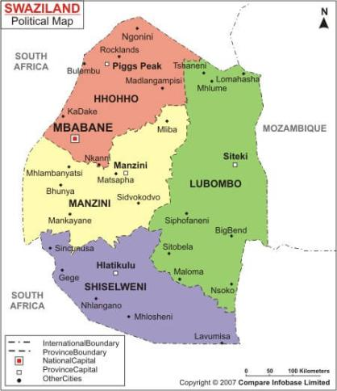
Distribution of Child Abuse Cases by Region, Swaziland, 2014
Hhohho Region | 1329*
Lubombo Region | 1505
Manzini Region | 1463
Shiselweni Region | 1181
Lubombo Region has 31% of child sexual abuse cases (328 reported in 2014)
Lubombo Population: 207,000
*National Surveillance on Abuse, 2014

Slide 6
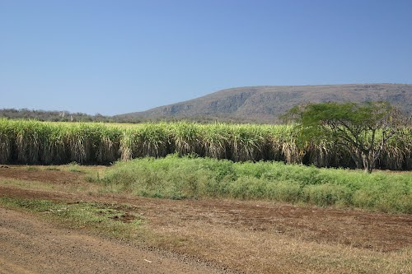
Lubombo SW Strengthening Pilot
HFG piloting strengthening SW sector in Lubombo Region
Supporting coordinated implementation of Swaziland’s Child Protection and Welfare Act of 2012

Slide 7
Rationale for Selecting Lubombo
Inadequate human resources
5 social workers, none with required qualifications

Slide 8
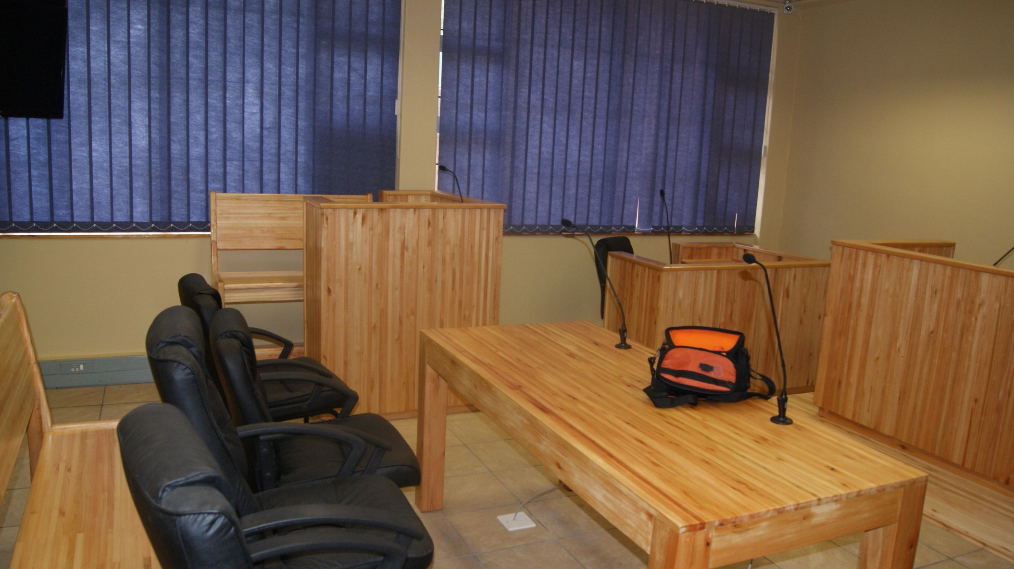
Importance of Child-friendly Courts
Original court required children to face the perpetrator
No resources to make children comfortable and facilitate testimony

Slide 9
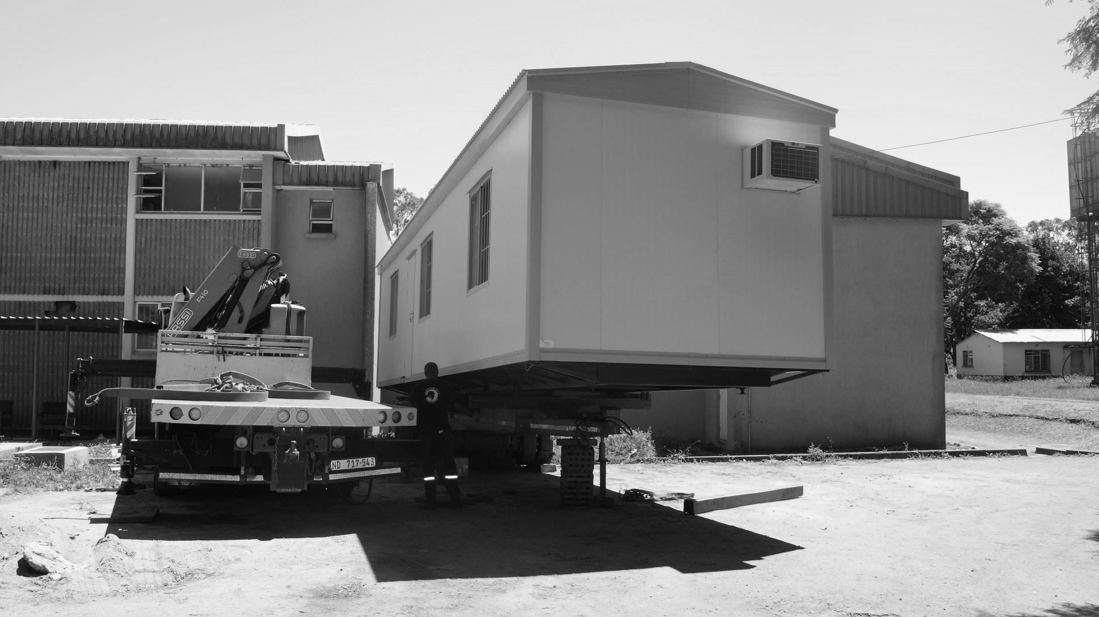
Redesigning the Child-friendly Court
Study tour to Palm Ridge & Soweto, SA
Designed Siteki CFC structure based on:
Study tour lessons learned
Ministry of Works consultations
PEPFAR engagement
Completed renovations to existing court
Purchased and furnished a mobile structure

Slide 10
Child Friendly Court Design
Notes:
Graphic of CFC and speak to it to include:
Modesty and yet advance element of facility
Two structures connected via two way camera system
Accessibility issues for child victim
Suitability for child victim in that they are never in contact with perpetrator
Equipment and accessories such as AC dolls

Slide 11
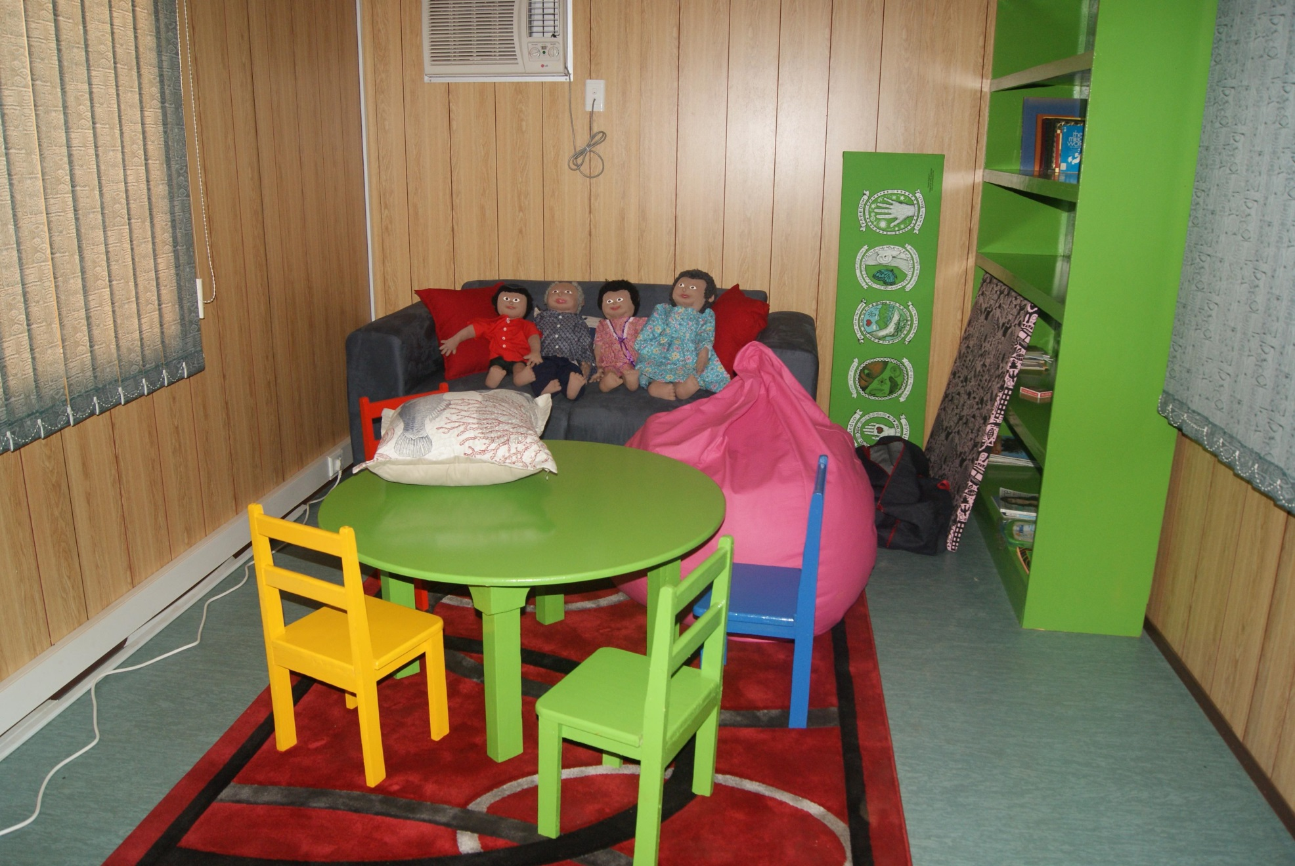
Mobile Structure for Children

Slide 12
Camera Link to Children’s Room

Slide 13
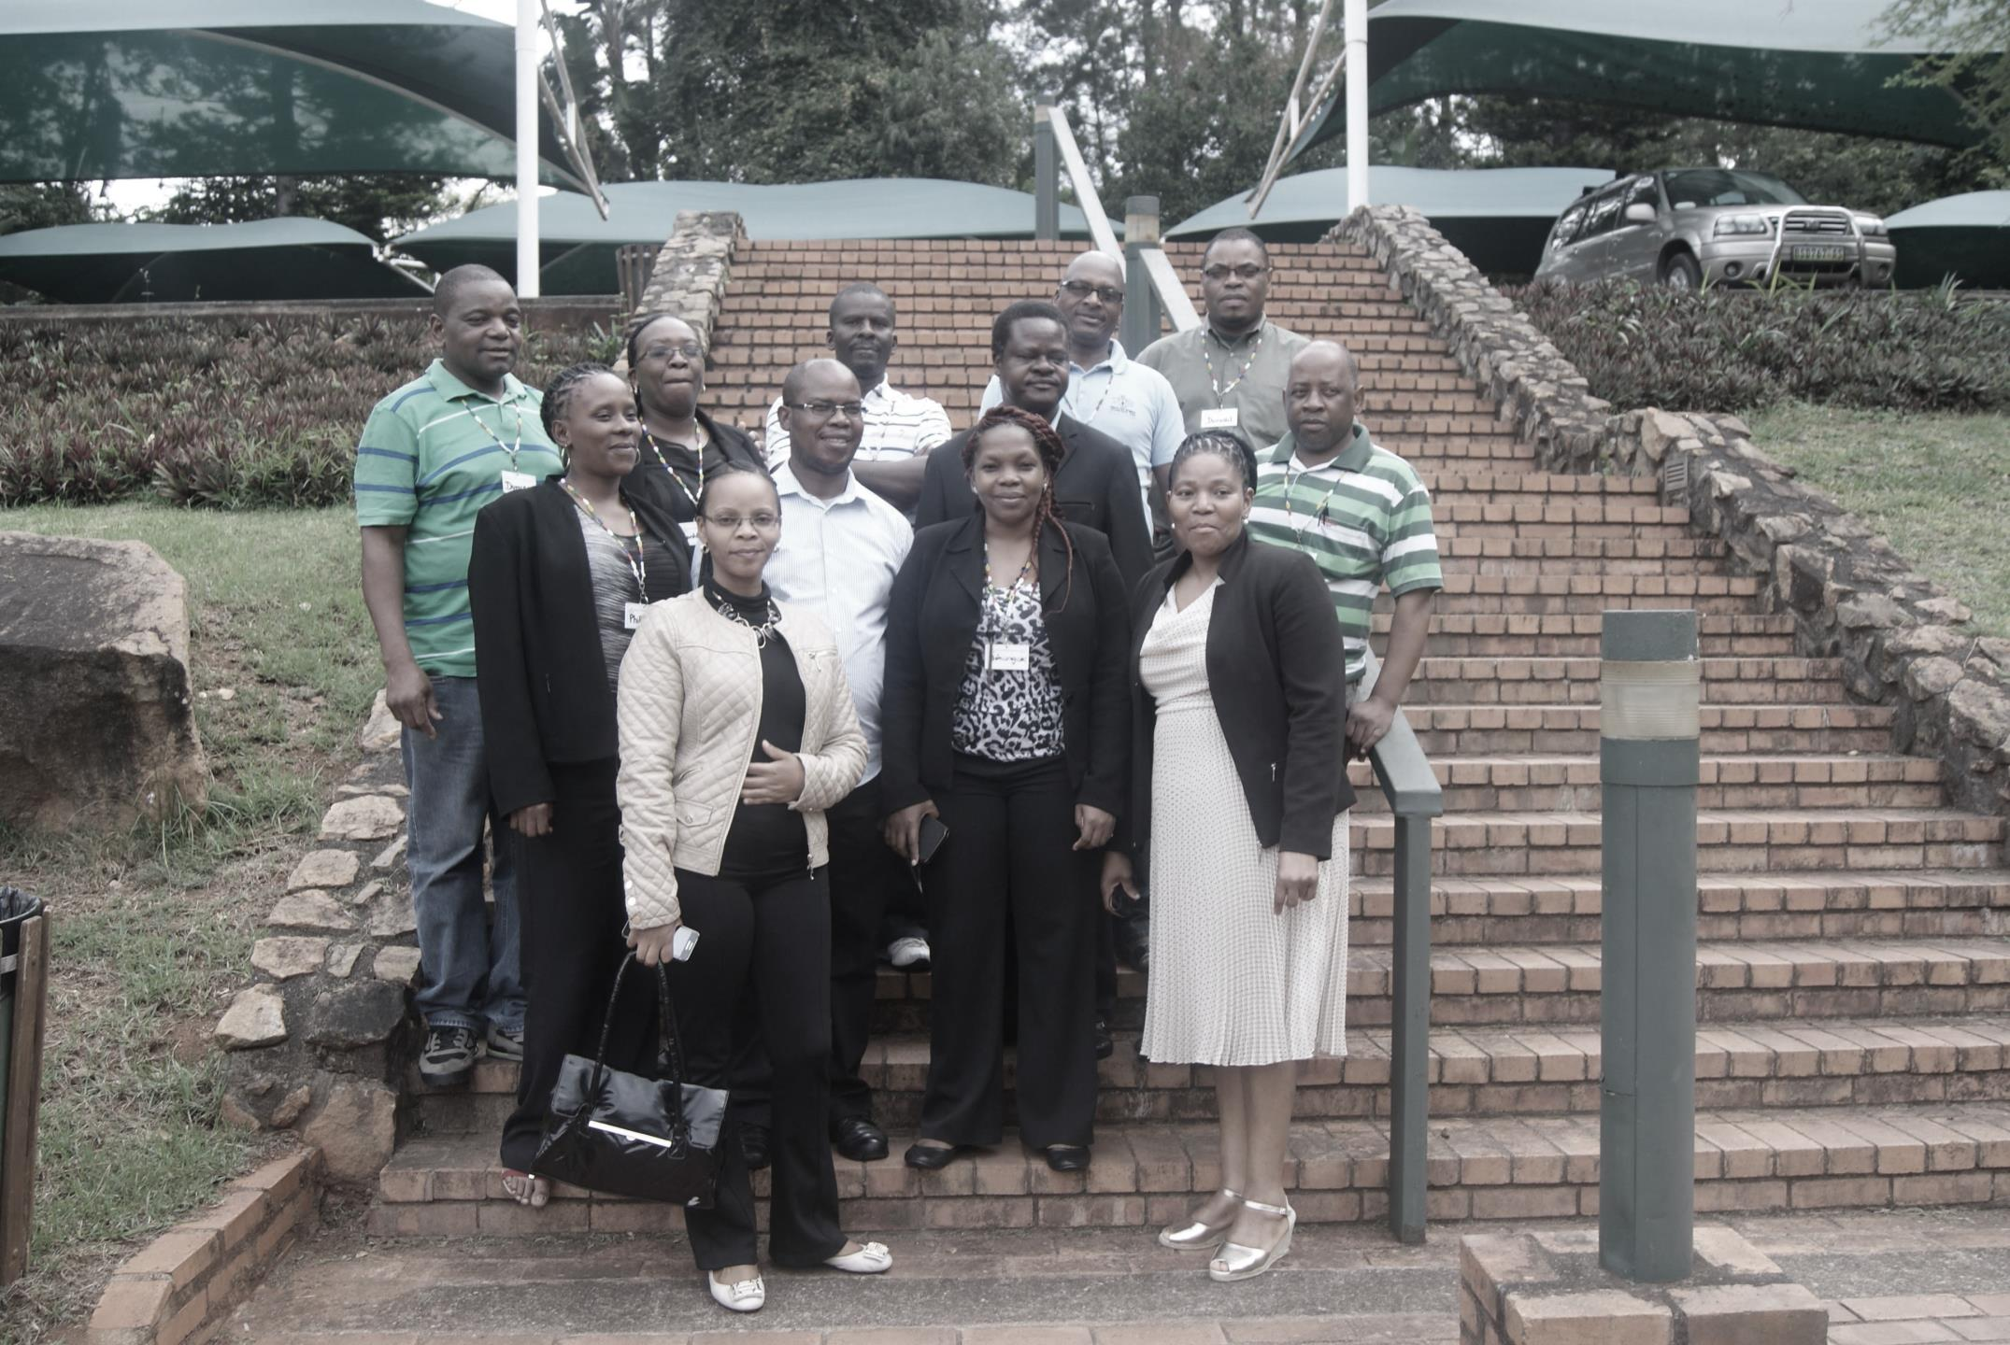
Capacity Building for CFC
Trained:
14 forensic social workers
14 social workers on Child Protection Welfare Act
10 prosecutors on legislation for using court intermediaries
Prosecutors (15), judicial officers (12) and court intermediaries (21) to understand respective roles and how to work together
We need a training plan to include in next year’s budget.” (Principal Secretary, Ministry of Justice)
Notes:
Initially started off by just looking at court Intermediaries and Social Workers.
It soon became apparent that all role players in the court need technical skills to compile child witness evidence.
Multi-sectoral approach
Outcome – 86 trained between January 2014 – June 2015

Slide 14
Accomplishments
CFC fully functioning—approx. 20 cases per month
Also serves sexually abused elderly women
Standard template for court reports endorsed by Judiciary and Ministry of Justice (MOJ)
Additional trainings planned with sustainable funding source (funded by MOJ, Judiciary and Police)
Department of Social Welfare owns the restructuring, supported by Ministry of Public Service
High-level stakeholder collaboration

Slide 15
Implications on SW Practice
Forensic SW Specialization
Where should SWs be placed? – practice and supervision
Case Management
Track SW cases and links SW, Courts, Prosecution, HIV/AIDS screening
Refining structure from national to chiefdom level, professionalization and deployment
Regulation
SW council to regulate the profession
Curriculum content to complement practice model
Linkages with HIV/AIDS – Screening is crucial
Notes:
Specialized SW’s that ideally should be under the MOJ/Judiciary
more positions have been allocated in current financial year as a result of PS assessment sparked by the pilot for decentralized service delivery which is different from what we had originally.
Development of a case management system that tracks SW cases and links SW, Courts, Prosecution as well as HIV/AIDS
Educator, negotiator, Supervisor, mentor,

Slide 16
Implications On SW Management
DIRECTORATE
CLINICAL SOCIAL WORK SECTION
Disability
Occupational Therapy
Clinical Psychology
Palliative Care
Substance Abuse
HIV/AIDS
Albinism
Social Marketing
CHILDRENS
SERVICES SECTION
Street Children
Children's Estate
OVC Program
Child Protection
Custody Cases
Adoptions
Child Placement
Child Maintenance
Schools Social Work
Forensic Social Work
Social Marketing
COUNSELLING SERVICES SECTION
Adult Abuse Cases
Human Trafficking
Disaster Management
Youth Services
Family & Gerontology
Food Security/Community Strengthening
Industrial Social Work
Social Marketing
CORRECTIONS
JUVENILES &
PROBATIONS SECTION
Children of Incarcerated Parents
Probations
Juvenile Delinquency
Corrections
Restorative Justice Procedure
Social Marketing

Slide 17
Stakeholder Feedback
“I came here thinking I know….this training has taught me that I don’t know anything” (Magistrate)
“What I have learnt in the past five days is that all I have been doing for the past 15 years was wrong” (Prosecutor)
“As a prosecutor for fifteen years, I was not aware about trauma caused by the court to child witnesses. The communication I learned would help me reduce this” (Prosecutor)

Slide 18
Ngiyabonga!!
Visit us at:
www.hfgproject.org

